Slide 1
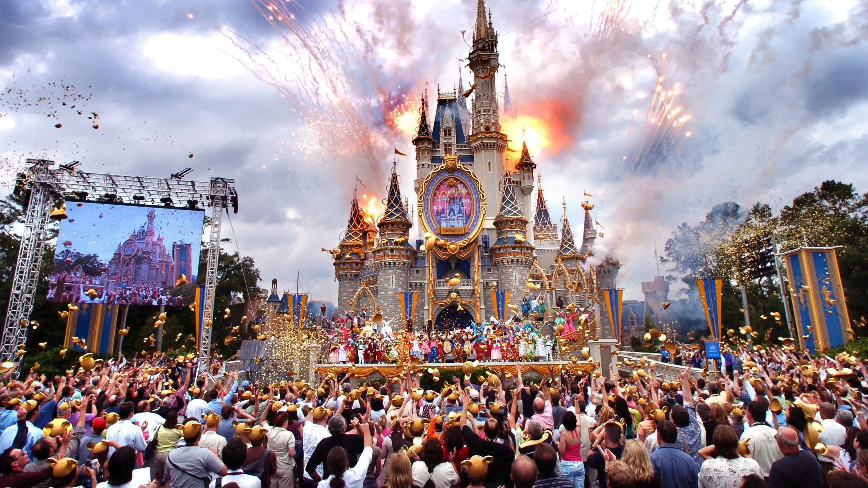
Magical Insights: Leveraging Text Analytics to Enhance Global Disneyland Experiences
By Group 3:
Tushar Marwah
Isaiah Smith
Michael Schroeter
Ben Padover

Slide 2
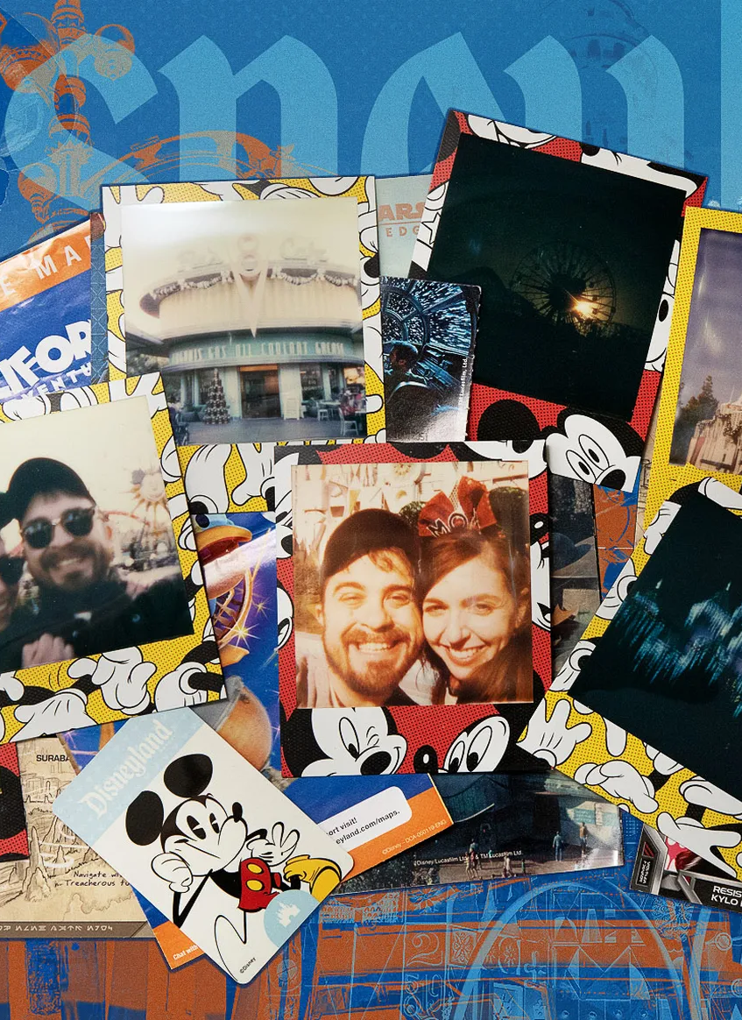
Understanding the Spectrum of Visitor Experiences at Disneyland Parks
Disneyland holds a legendary status, offering magical experiences to visitors from across the globe.
Challenge: Not just to maintain its high standards of visitor satisfaction but to understand and adapt to the nuanced expectations of a diverse global audience.
Visitor satisfaction is the cornerstone of the theme park industry, directly influencing repeat visits, word-of-mouth recommendations, and overall brand loyalty
Understanding visitor sentiment and feedback at a granular level allows Disneyland to tailor experiences, anticipate visitor needs, and implement improvements that resonate across different cultural contexts.
Objective: Deep dive into 42,000 TripAdvisor reviews across three Disneyland parks fine-tune services and enhance visitor experiences by understanding diverse feedback.

Slide 3
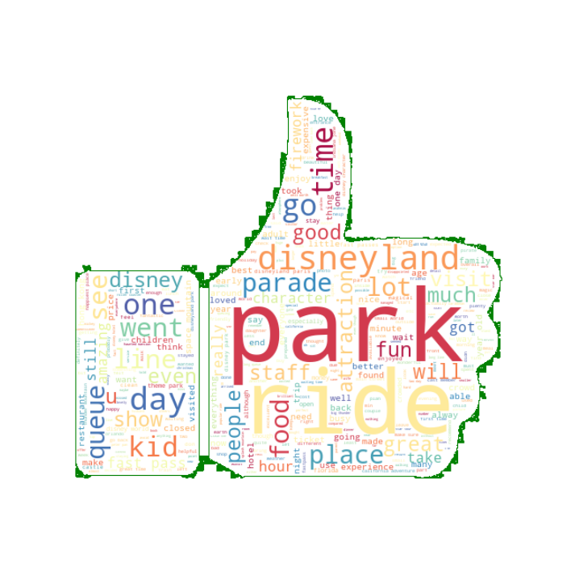
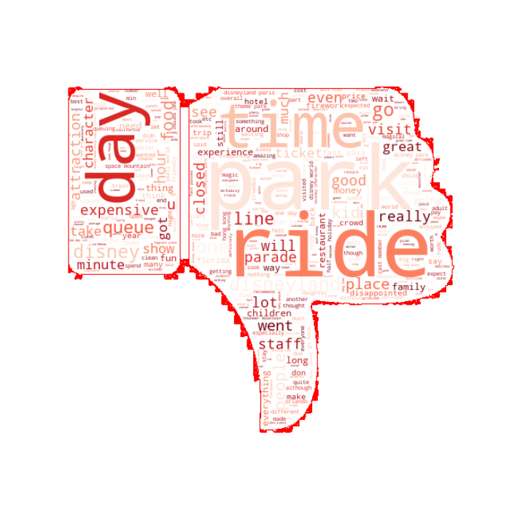
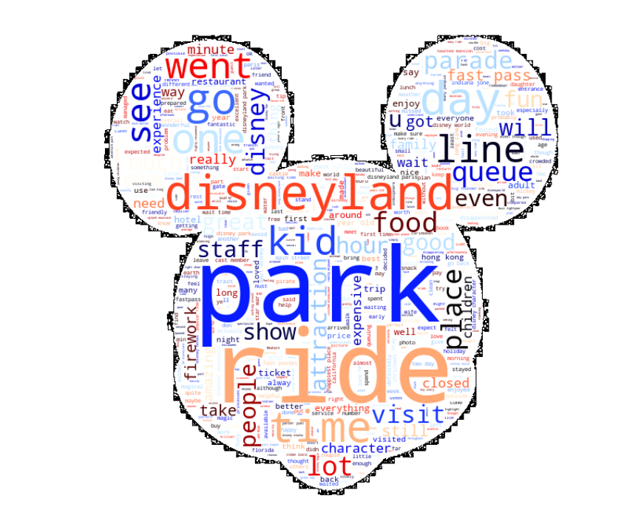
Deep dive into the Data
Dataset Overview:
Utilizes 42,000 TripAdvisor reviews from Disneyland parks in Paris, California, and Hong Kong.
Reviews include Review ID, Visitor Rating, Visit Date, Reviewer Location, Review Text, Park Location.
Preprocessing Strategy:
Text Normalization
Stopword removal and tokenization
Impact of Data on Analysis:
This rich dataset offers a global perspective on visitor satisfaction, serving as the cornerstone for our analysis. It enables a nuanced understanding of visitor feedback, driving targeted improvements across Disneyland parks.

Slide 4
!. Exploratory Analysis
2. Sentiment Analysis – Emotion Detection
3. Polarity and Subjectivity of Sentiments
4. Cluster Analysis
5. Topic Modeling for Branches
Data Analysis Process

Slide 5
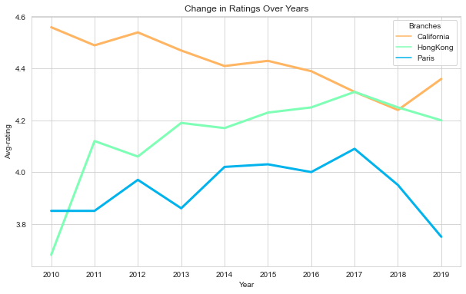
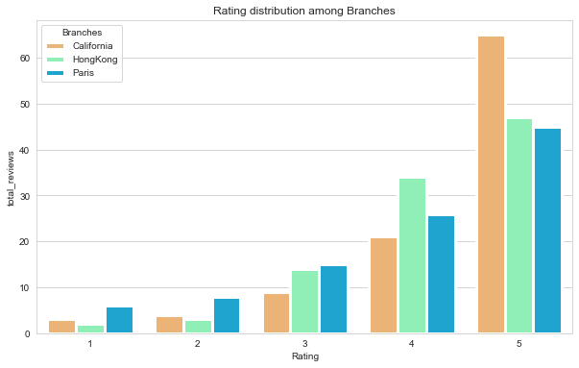
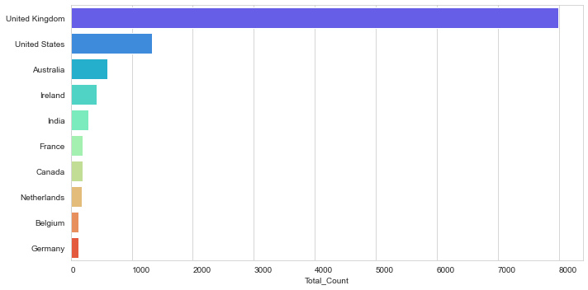
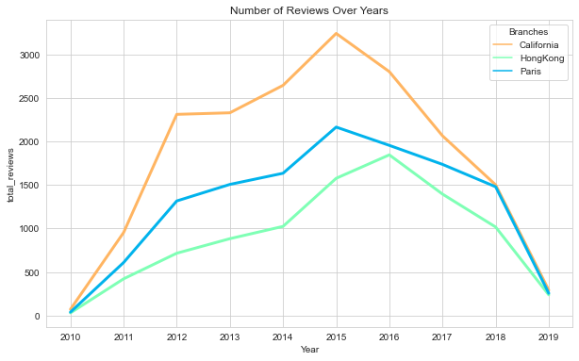
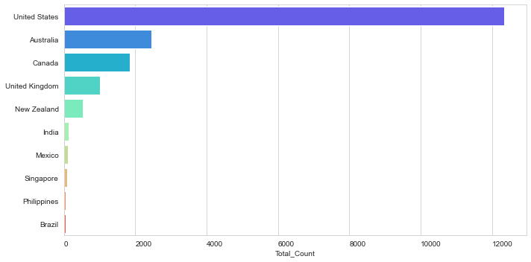
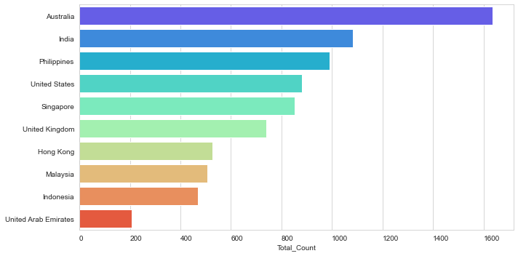
Exploratory Data Analysis
Top 10 review locations for Disneyland branch in Paris
Top 10 review locations for Disneyland branch in California
Top 10 review locations for Disneyland branch in Hong Kong

Slide 6
Insights into Exploratory Data Analysis
First, we performed exploratory data analysis (EDA) to get a general idea of average ratings across all locations, where our visitors are from, and how the ratings changed over time.
We found the average rating for each park (out of 5 stars): 4.41 for California, 3.96 for Paris, and 4.20 for Hong Kong.
Visitor nationality depended on location — for example, many Hong Kong visitors are from countries nearby (i.e. Australia, India, Philippines), most of Paris’s visitors are from the United Kingdom, and many of California’s visitors are from the United States.
In general, the reviews from all three locations mention fast passes, lines or queues, visitor demographic, rides and attractions.

Slide 7
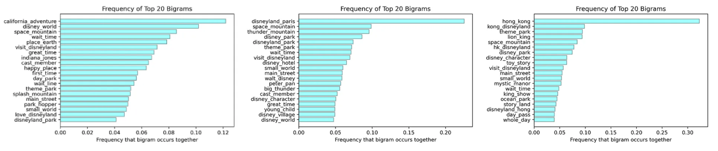
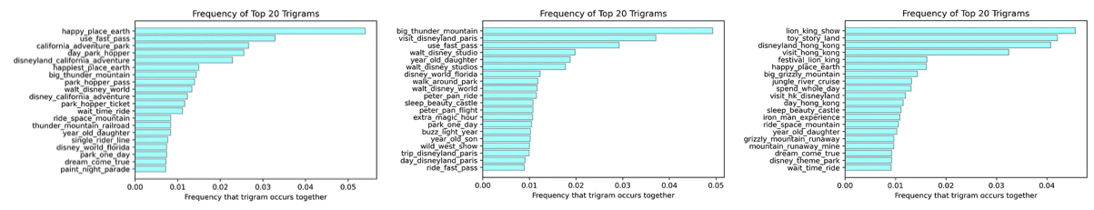
Word Representations
Left to Right: California, Paris, Hong Kong
Notes:
The most frequent bigrams mention popular attractions, type of ticket used (day pass, park hopper), employees (cast member), and wait time.
It seems that visitors who go to the California location would encourage others to “use fast pass” for shorter wait time. These reviews also talk about California Adventure, compare their experience to Walt Disney World in Florida, using park hoppers, and popular park attractions. Paris reviewers also mention using fast passes, popular attractions, and comparing to other park locations.
Reviews about Hong Kong mention popular attractions and wait times for rides.

Slide 8
Insights into Word Representations (1/2)
Key Trigrams and Their Implications:
"happy place earth": Likely a snippet from the phrase "happiest place on earth." This reflects the overarching brand message Disneyland aims to convey and the expectations visitors might have.
"use fast pass" and "adventure park hopper": These trigrams suggest practical advice or feedback about using Disneyland’s FastPass system and park hopper tickets, which enhance convenience and access to multiple attractions.
"big thunder mountain" and "space mountain big" (Paris): Specific references to popular attractions indicate what guests are particularly drawn to or remember about their visits.
"visit disneyland paris" and "visit hong kong": Direct mentions of visiting specific Disneyland locations, indicating reviews that are likely sharing travel experiences or suggestions.
"california adventure park": This indicates discussions specifically centered around the California Adventure park, distinct from the main Disneyland park.
"long wait times" and "lion king show" (Hong Kong): Reflects common operational feedback or noteworthy attractions, respectively. Long wait times are a frequent concern in theme parks and could signal areas needing efficiency improvements.

Slide 9
Insights into Word Representations (2/2)
Analytical Insights:
Visitor Experience: The trigrams show what visitors are most likely to comment on, such as key attractions like "Space Mountain" or services like "Fast Pass." Understanding these focal points can help Disneyland prioritize which aspects of the guest experience require attention or enhancement.
Operational Feedback: References to "long wait times" provide direct operational feedback that can be actionable. Disneyland might use this data to manage queues better or to optimize the scheduling of popular shows and rides to distribute guest flow more evenly.
Marketing and Communication: Knowing that phrases like "happy place earth" resonate with visitors can help in crafting targeted marketing campaigns that reinforce this message and highlight visitor testimonials that align with this theme.
Cultural and Regional Differences: The distinctions in trigrams among different parks (Anaheim, Paris, Hong Kong) could also guide localized marketing strategies and operational adjustments. For instance, certain attractions might be more popular or relevant in one region over another.

Slide 10
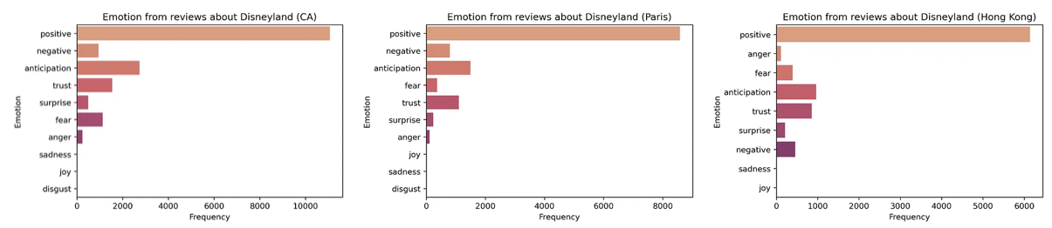
Sentiment Analysis – Emotion Detection
The entire trip was marred with sickening service and bad experiences…There is no magic even to my kids.
It is no doubt a legendary place, but I just don't think it's worth the money - overcrowding
Don't waste your time with Euro Disney… staff were unfriendly, rude

Slide 11
Insights into Emotion Detection
We assigned emotions using NRCLex, which measures emotional affect based on text. The emotional affects include positive, negative, anticipation, trust, fear, surprise, anger, sadness, joy, and disgust.
Overall, all three parks have a high frequency of “positive” emotion. However, we have to take a closer look at reviews associated to negative emotions (anger, fear, negative, disgust, sadness) so that we can have an idea of why some visitors had an unpleasant park experience.
We found some interesting reviews where emotions were classified as “disgust” or “negative”:
Customer service in Paris: “Don't waste your time with Euro Disney… staff were unfriendly, rude and not at all interested in customers! If you do not speak French, you are ignored!”
Prices in California: “It is no doubt a legendary place but I just dont think it's worth the money and headache of overcrowding and overpriced everything. Disney continues to raise the price of admission and the crowds are ridiculous every single day.”
Customer service in California: “Having been to Disneyworld in Florida the California Disneyland is a let down. It was dirty in restrooms. Food server would turn around and pick nose.”
Hotel accommodations, customer service, park accessibility, and lines in Hong Kong: “Was there during the Christmas holidays. The entire trip was marred with sickening service and bad experiences…The is no magic even to my kids. The staff there are mostly sulking (maybe because they need to be working over the holidays).

Slide 12
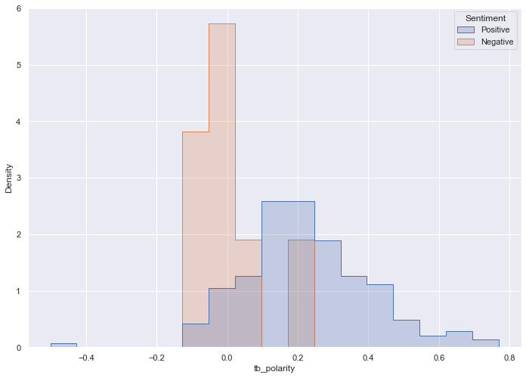
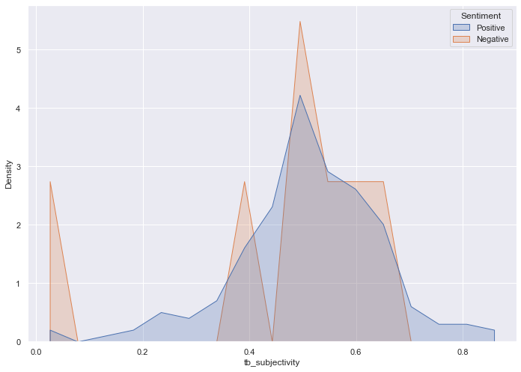
Sentiment Analysis - Polarity of reviews on experience
We wanted to see how much sentiment polarity and subjectivity is influencing how visitors review their experience at Disneyland:
People who have negative things to say also have higher polarity than the one that have positive things to say.
Linking back to the reviews, we can say that people who hold negative opinions on it are harsher in their reviews because they came in with higher expectations and ended up having a unsatisfied/ mismatched experience.
Seems like people who have positive things to say are more subjective in their reviews than those some of the naysayers !
Notes:
Polarity Analysis:
Polarity measures how positive or negative a text is. Scores closer to +1 indicate a highly positive sentiment, scores closer to -1 indicate a highly negative sentiment, and scores around 0 are neutral.
The first graph shows a wider spread of polarity for negative reviews compared to positive ones, suggesting that negative sentiments vary greatly in their degree of negativity.
Negative reviews seem to have higher polarity (more strongly negative) than positive reviews, implying that unhappy guests may have stronger feelings or more extreme expressions of dissatisfaction than those who left positive reviews.
Subjectivity Analysis:
Subjectivity measures whether the text is based on facts (objective) or opinions and feelings (subjective). Scores closer to +1 indicate high subjectivity, while scores closer to 0 indicate objectivity.
The second graph indicates that both positive and negative reviews have a broad range of subjectivity, with a peak in the center for negative reviews. This might suggest that people with negative opinions often include personal feelings or experiences in their reviews.
There is a notable spike in subjectivity for negative reviews around the midpoint, implying that negative reviews tend to contain more personal opinions rather than objective facts.

Slide 13
Cluster Analysis: Process Workflow (1/4)
The cleaned text data is tokenized, meaning it is split into a list of words, which is a necessary step for Word2Vec training.
The code generates bigrams and trigrams (combinations of two and three words that frequently occur together) to preserve the context that might be lost when looking at single words.
The Word2Vec model is trained with the specified parameters, using the preprocessed text data that includes bigrams and trigrams. This creates embeddings for each word/phrase.
K-means is used to cluster the standardized word vectors. A function calculate_distortion computes the K-means inertia for different numbers of clusters (k), which is a measure of how internally coherent the clusters are.
The elbow method is used to determine the optimal number of clusters by plotting the distortion scores (inertia) against the number of clusters.
The 'elbow' point in the plot is where the rate of decrease sharply changes, indicating a good balance between the number of clusters and the within-cluster sum of squares (inertia).
The cluster centers are then visualized in a 2D scatter plot, and each word is assigned to its closest cluster.
The plots show how well the data can be separated into clusters, and the top terms in each cluster can provide insights into common themes or topics in the text data.
8
7
6
5
4
3
2
1

Slide 14
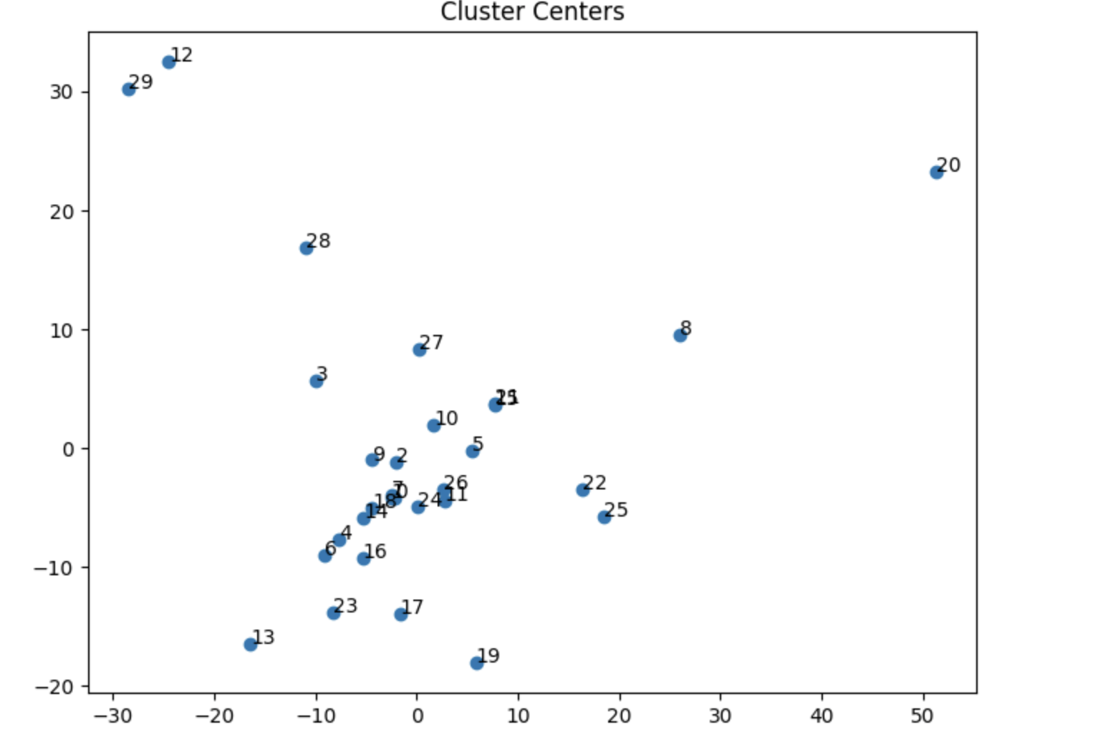
Cluster Analysis: Summary of Clusters (2/4)
Summary of Clusters:
Logistics and Planning: Trip planning, Fast pass strategies, ques
Family and Children’s Experiences: Family-centric nature of park
Service Quality: Quality of customer care
Comparisons & Expectations: reflection on past visits
Emotional Responses: joy, nostalgia, disappointment, frustration
Financial considerations: Overall value for money or not
Crowds & Waiting Times: Impact of crowds on experience
Staff & Cast Members: Interactions with employees/staff

Slide 15
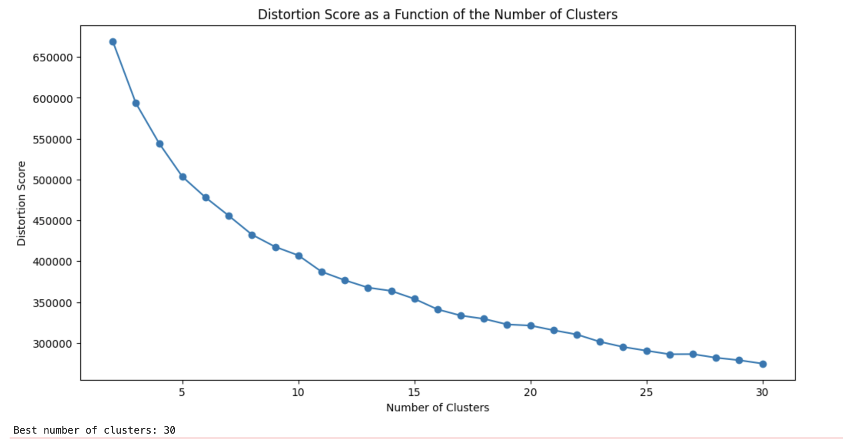
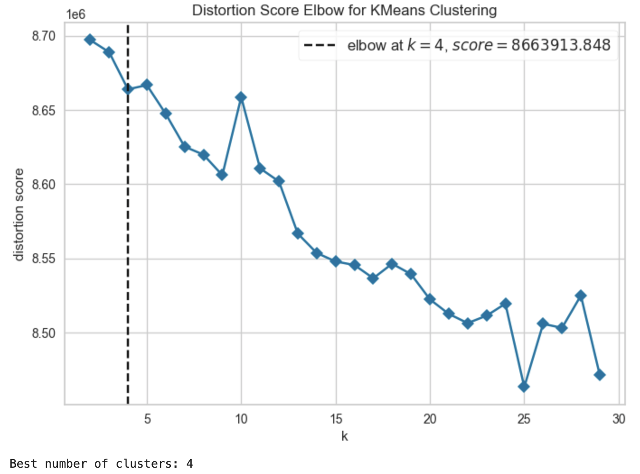
Cluster Analysis: Word2Vec Model + Kmeans (3/4)
Distortion Score as a function: This graph is showing us how well different numbers of clusters organize the data. The "distortion score" is a measure of how close each point in our data is to the center of its cluster - basically, how well the cluster "fits" its points.
As we look from left to right, we’re trying more clusters. Initially, the score drops rapidly, meaning each extra cluster is helping a lot. But as we keep going, the improvements get smaller and smaller.
Cluster Centers: This image shows where the "centers" of our clusters are in a 2D plane after we've simplified our data using PCA.
Distortion Score Elbow: This plot is a zoomed-in version of the distortion scores we looked at earlier, focusing on fewer clusters. The "elbow" is the point where adding more clusters doesn't give us as much of a benefit in fitting our data anymore. Here, it’s identified at 4 clusters.
Notes:
Summary of clsuters:
Logistics and Planning: Several clusters focus on the practical aspects of visiting Disneyland, such as trip planning, FastPass strategies, and queue management.
Family and Children’s Experiences: Some clusters highlight the family-centric nature of the park, discussing children's rides, family-friendly services, and accommodations.
Service Quality: Clusters reveal insights into guest interactions with staff, the perceived value of services, and the quality of customer care.
Dining and Accommodation: Feedback on food quality, dining experiences, and hotel stays are common, pointing out both positives and critiques.
Comparisons and Expectations: Guests compare different Disneyland parks and their experiences to expectations, often reflecting on past visits.
Emotional Responses: Clusters indicate a range of emotions, from joy and nostalgia to disappointment and frustration.
Financial Considerations: The cost of tickets, food, and souvenirs, along with discussions about overall value for money, appear frequently in the clusters.
Crowds and Waiting Times: A recurring theme is the impact of crowds on the experience, particularly in relation to wait times for attractions.
Staff and Cast Members: Interactions with Disneyland employees and cast members are frequently mentioned, affecting the overall guest experience.

Slide 16
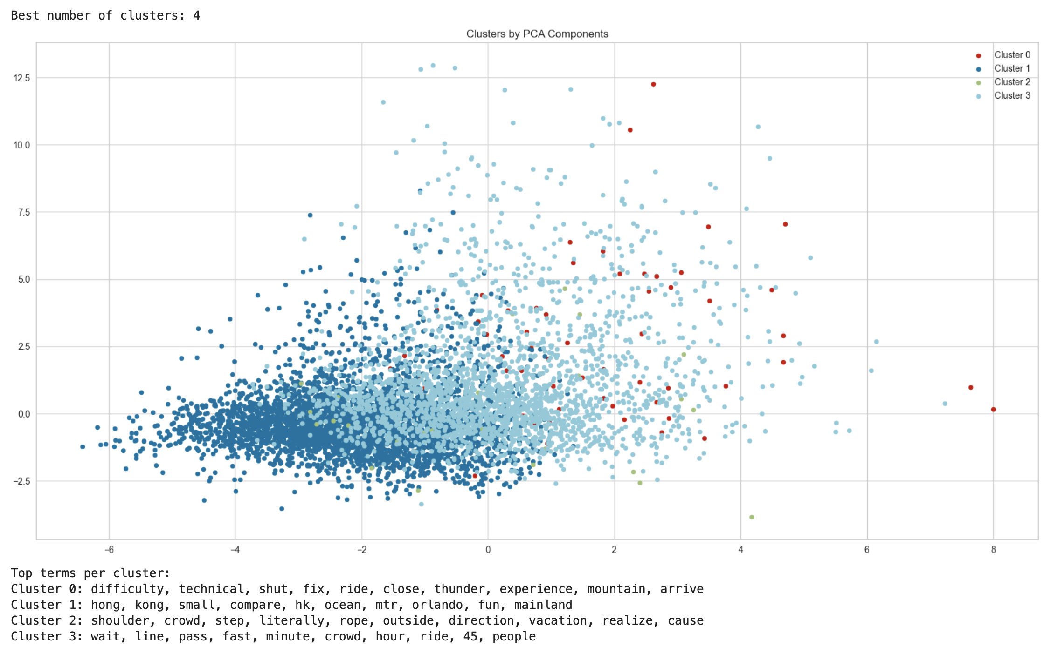
Cluster Analysis: Word2Vec Model + Kmeans (4/4)
Cluster 0 (Technical and Ride Issues):
Terms like "difficulty," "technical," "shut," and "fix" suggest that visitors are discussing technical issues or challenges with rides.
Collecting data on ride downtimes and malfunctions can pinpoint areas for maintenance improvements.
Guest feedback on specific rides can be analyzed to detect patterns in ride issues.
Cluster 1 (Locations and Experiences):
Surveys or focus groups could delve deeper into visitor comparisons between parks to extract nuanced preferences.
Marketing strategies could be tailored to highlight unique features of each location.
Experiences that are highly praised at one park could be replicated or adapted at others.
Cluster 2 (Crowd Management ):
Tracking real-time crowd movements with sensors and apps can inform immediate crowd control measures.
Long-term park layout adjustments could be informed by data on crowd flow and high-density areas.
Introducing more attractions or adjusting showtimes could distribute crowds more evenly throughout the day.
Cluster 3 (Waiting times):
The waiting experience. Virtual queuing and expanded FastPass options could reduce physical waiting times.
Implementing a reservation system for rides could help manage and distribute the crowd throughout the day.
In-queue entertainment or interactive elements could improve
Notes:
Cluster Analysis:
Cluster 0 (Technical and Ride Issues): Terms like "difficulty," "technical," "shut," and "fix" suggest that visitors are discussing technical issues or challenges with rides. Disneyland could investigate and address recurring technical problems to improve ride reliability and guest satisfaction.
Cluster 1 (Locations and Experiences): References to specific locations like "Hong Kong" and "Florida," paired with words like "compare" and "ocean," might indicate comparisons between different Disneyland parks. Understanding these comparisons could help align the experiences offered at various locations.
Cluster 2 (Crowd Management): Words like "shoulder," "crowd," and "step" imply discussions about crowded spaces and visitor movement within the park. This suggests a need to improve crowd management strategies and possibly to enhance the design of walking paths and queues.
Cluster 3 (Waiting Times): With terms such as "wait," "line," and "minute," there is a clear emphasis on the waiting experience. Disneyland could focus on reducing wait times, possibly by optimizing the FastPass system or introducing more engaging activities in queue areas.
Customer Insights:
Based on this analysis, Disneyland can act on the following insights:
Ride Maintenance: Investigate reports of technical issues with rides and implement a more proactive maintenance schedule to prevent ride closures and ensure a seamless experience for visitors.
Park Experience Standardization: Analyze visitor comparisons across different parks to understand which features or experiences could be standardized or adapted to meet or exceed visitor expectations consistently.
Crowd Flow Improvement: Review the design and management of high-traffic areas to improve visitor flow and comfort. This could include better signage, designated walking lanes, or even remodeling certain park areas.
Queue Management: Continue to innovate in queue management, potentially expanding the FastPass system or introducing entertainment and interactions in line to make the waiting part of the experience rather than a negative aspect.
Visitor Engagement: Engage with visitors to address their concerns and suggestions, perhaps by using surveys or feedback stations throughout the parks, ensuring that visitor feedback is continuously collected and acted upon.
Personalized Experiences: Develop personalized experiences based on visitor preferences to reduce the impact of negatives like waiting times. For example, suggest alternative attractions with shorter wait times or provide personalized schedules to visitors based on their interests.

Slide 17
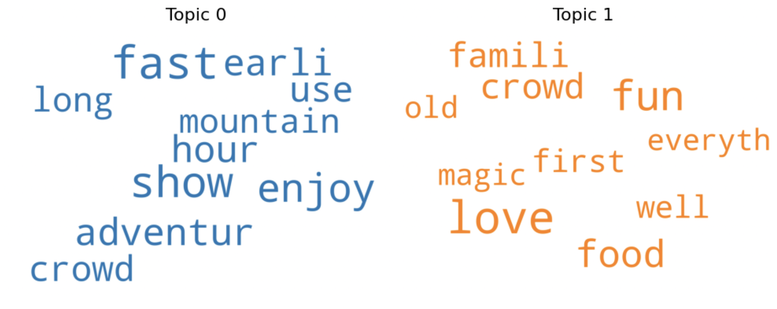
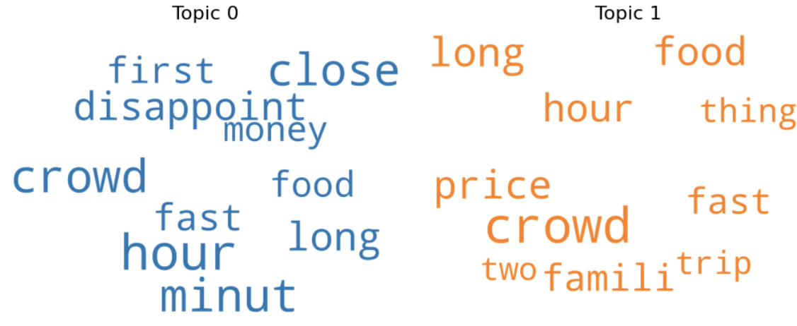
Topic modeling on Positive and Negative reviews - California
Positive Review Topics
Topic 0: Theme Park Attractions and Shows Experience
This topic focuses on visitors’ experiences with theme park attractions and shows. It may also include tips on avoiding long crowds and making the most of early hours.
Topic 1: Overall Theme Park Experience
This topic covers the overall experience of visiting the theme park, including food and dining, crowd levels, family-friendliness, and the general fun and love for the atmosphere of the park.
Negative Review Topics
Topic 0 : Disappointing Crowd Experience
The topic seems to be about the disappointment that the crowd experience brings. Words like “crowd”, “close”, and “long”, “hour”, “minute” suggests that the crowds are overwhelming causing long-hour delays, and the experience is not enjoyable.
Topic 1 : Unsatisfactory Food and Price at Crowded Restaurant
This topic may be about unsatisfactory food and price along with the crowd spoiling the experience on trip.

Slide 18
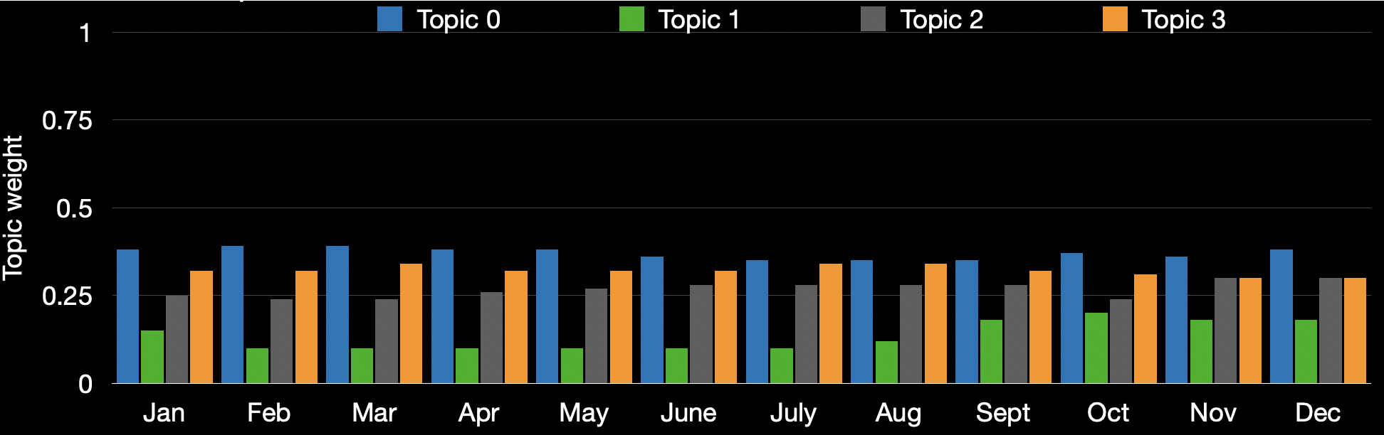
Topic distribution across seasons and months - California
Managerial Implication:
Focus on implementing effective crowd management strategies, such as limiting visitors, improving ride queues, and increasing staff.
It should also expand its festive experiences and offer unique events throughout the year, promoting them to attract more visitors.
Enhancing the fireworks and parade shows, adding new attractions and experiences can help keep visitors engaged and returning.
Disneyland could also consider implementing digital tools to help visitors plan their visit and make the most of their magical adventure.
Improving the quality and variety of restaurant food by offering more choices, and discounts, and addressing visitor complaints can further enhance the visitors’ experience.
Notes:
Topic 0 - Crowd management : This topic can cover the management of the crowd at Disneyland California. The discussion can revolve around the strategies used by the management to control crowds, the peak hours, how the prices of the tickets affect the crowd, and the overall experience of the visitors.
Topic 1 - Festive experiences : This topic can cover festive experiences, such as Halloween and Christmas celebrations. The discussion can be around different themes, the decorations, and the overall experience of celebrating these festivals at Disneyland California.
Topic 2 - Fireworks and shows: The discussion can revolve around the different fireworks and shows, the timings, the character interaction, and the overall experience of watching these shows.
Topic 3 - Fastpass enhancing Magical adventures : This topic can cover the different attractions, and experiences. The discussion can be around the most popular attractions, how to plan your visit using fastpass, and the overall experience of going on a magical adventure at Disneyland California.
The importance of effective crowd management at Disneyland California cannot be underestimated as it affects every visitor to the park, with millions of guests each year. The festive experiences such as Halloween and Christmas celebrations, while enjoyed by many, may not be universally appealing and could potentially bring additional crowds, causing visitors to avoid the park during those times.

Slide 19
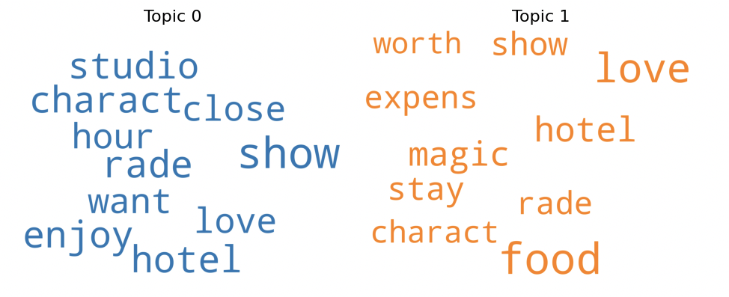
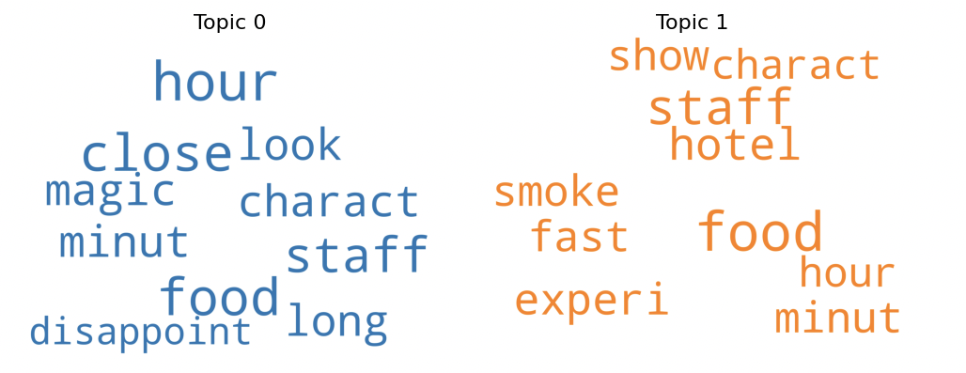
Topic modeling on Positive and Negative reviews - Paris
Positive Review Topics
Topic 0: Unforgettable Memories and Magical Experiences
This topic focuses on positive reviews and experiences shared by visitors to Disneyland Paris. It explores the various aspects of the park that guests enjoyed, such as the rides, shows, hotel stays, and character interactions. The topic is mainly about visitors’ great experience.
Topic 1: Culinary Delights of Disneyland Paris
This topic seems to focus on the dining options available at Disneyland Paris, discussing the different types of food options available. It could also explore the cost of dining at Disneyland Paris and whether the unique experience is worth the expense, such as character dining or themed restaurants.
Negative Review Topics
Topic 0: Negative Reviews about Restaurant Food and Service
This topic is about negative reviews related to restaurant experiences. Customers might express their dissatisfaction with the food quality, staff being unhelpful or rude, long wait times, or feeling disappointed with their overall experience.
Topic 1: Negative Reviews about Hotel Accommodation
This topic is about negative reviews related to hotel accommodation experiences. Customers might express their dissatisfaction with the hotel’s services and amenities such as a smoke-free environment. Additionally, guests may have negative feedback about their experiences with hotel shows and characters.

Slide 20
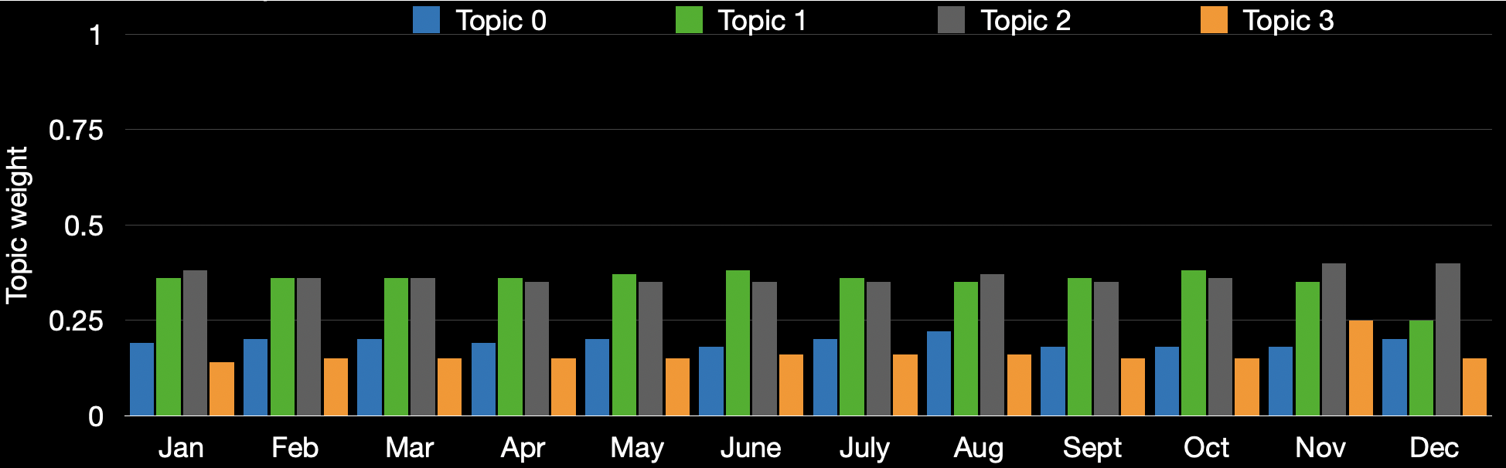
Topic distribution across seasons and months – Paris
Managerial Implication:
Disneyland Paris could improve food quality, staff training, reduce wait times, invest in hotel cleanliness and listen to guest feedback.
They could introduce healthier food, a fast pass system, and update amenities.
Promotions and events could also be tailored to each season’s interests, such as offering more Fast Pass options in summer and promoting unique hotel and restaurant features during winter.
Guest feedback can be encouraged through surveys and social media monitoring to ensure visitors have the best experience possible.
Notes:
Topic 0 - Character Experiences at Disneyland Paris: The topic discussed the impact of character interactions at rides, bookstores, shows, food restaurants, and hotels.
Topic 1 - Fast Pass for great overall experiences: This topic discussed different attractions at Disneyland Paris and how to maximize the experience by using the Fast Pass system.
Topic 2 - Hotel Accommodations and Dining : This topic may be about the various hotels and restaurants available at Disneyland Paris, including options for different budgets and tastes.
Topic 3 - Tips and Tricks for a Magical Visit : This topic seems to be about insider tips and advice on how to make the most of your visit to Disneyland Paris.
Topic 2 is most discussed in Winter and Topic 3 is the least discussed. Topic 1 is slighlty more discussed in Summer, Spring than Topic 2 may be because crowd and long lines are major concern for themepark and fastpass can enhance the overall experience. Topic 2 is most discussed during winter as visitors are more focused on indoor experiences, such as dining and staying in hotels. Fall has an equal discussion on both topics due to moderate crowds and a balanced interest in both experiences.

Slide 21
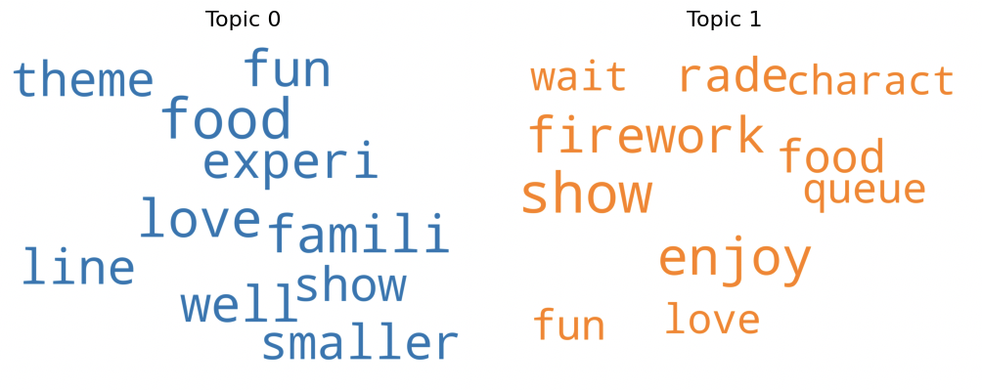
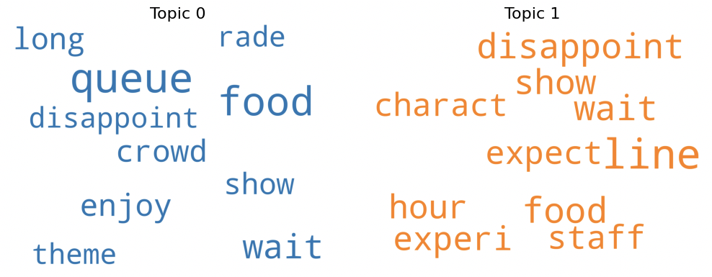
Topic modeling on Positive and Negative reviews – Hong Kong
Positive Review Topics
Topic 0: Experience of Attending a Theme Park
This topic explores the different aspects of visiting a theme park, such as the food, theme, shows, and overall experience. It could also delve into the excitement and fun of going to a theme park, and how it can create lasting memories with family and friends.
Topic 1: Enjoyment of Firework Show
This topic could focus specifically on the experience of watching firework shows. The topic could also discuss the emotions and feelings associated with watching fireworks, such as joy, fun, and loving it all. Additionally, it could also be possible to discuss navigating the long queues to see the firework.
Negative Review Topics
Topic 0: Disappointing experience at a crowded theme park
The first negative topic explores the downsides of visiting popular theme parks, such as overcrowding, long wait times, and disappointment with attractions or food.
Topic 1: The frustrations of dining out at busy restaurants
This topic focuses on the challenges and frustrations of dining out at busy restaurants, such as dealing with long wait times, slow service, and food that fails to meet expectations.

Slide 22
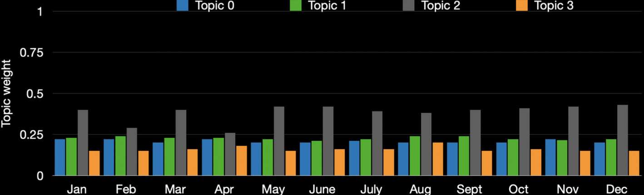
Topic distribution across seasons and months – Hong Kong
Managerial Implication:
Managing visitor capacity, expanding attraction and dining options, improving communication, increasing staffing levels, using technology, and enhancing menu offerings.
Furthermore, the park’s popular entertainment options, such as shows, parades, fireworks, and character interactions, have generated significant buzz among visitors.
Disneyland Hong Kong could continue to focus on and expand these entertainment offerings to provide the best possible experience for its visitors.
Notes:
Topic 0 - Theme park experiences : This topic seems to be on the general experience of visiting a theme park, including waiting in lines and watching fireworks, enjoying shows and attractions.
Topic 1 - Food and dining: This topic can cover the food and dining options available at theme parks, including the quality of the food, the variety of options, the cost, and the overall dining experience.
Topic 2 - Entertainment: This topic can explore the different forms of entertainment available at theme parks, such as shows, fireworks, and food as well as the characters and mascots that visitors can interact with.
Topic 3 - Queue management : This topic can focus on the management of queues at theme parks, including how long visitors have to wait, the efficiency of the queue system, and ways to improve the overall queue experience.
Visitors may be having such a great time enjoying the shows, parades, and attractions that they do not focus on discussing the queues. In this scenario, it is not necessarily that the queue management is quite good, but it may happen that the visitors are having such a positive experience with the entertainment options that it takes precedence in their discussions and memories of the park.

Slide 23
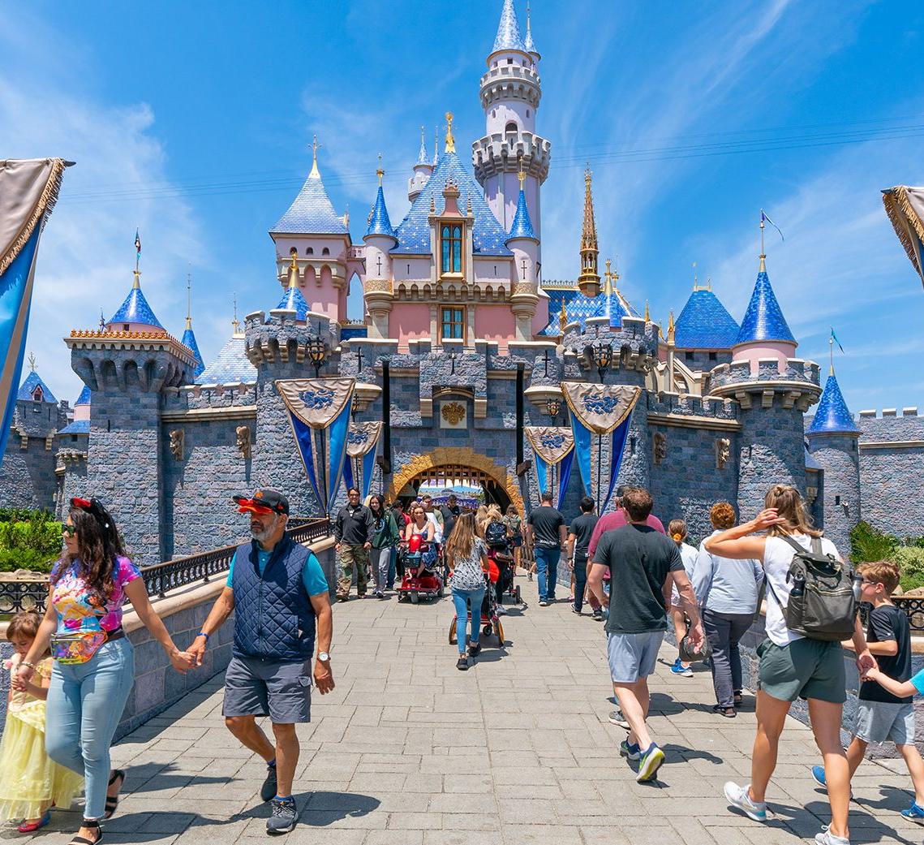
Shaping the Future: From Insights to Action at Disneyland
The Road Ahead:
Marking the beginning of a continuous journey towards excellence in visitor satisfaction at Disneyland parks.
Empowering Disneyland to make informed decisions that resonate with visitors' evolving preferences and expectations.
Beyond immediate improvements, our analysis offers a blueprint for ongoing adaptation and innovation, ensuring Disneyland remains at the forefront of visitor experience excellence.

Slide 24
Thank You!

